Slide 1
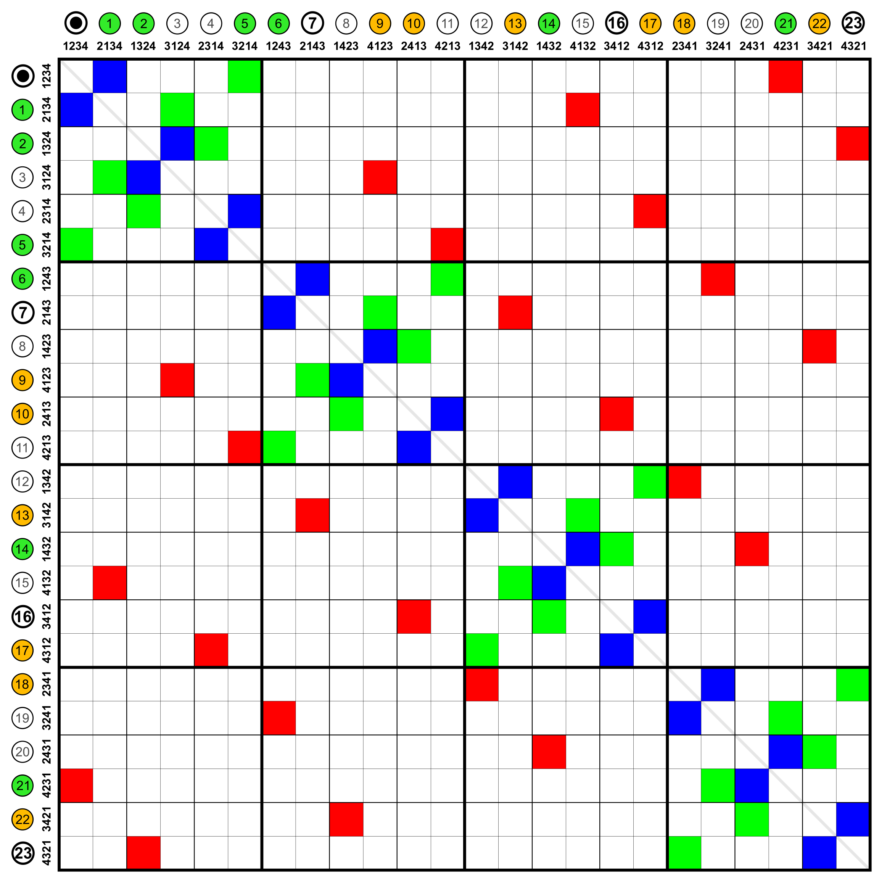
Minesweeper
User’s Interface
Interface Node
Request Update Representation
Transmit State
Step 03
Step 04
1--------------------- 1
1--------------------- *
Step 02
Step 01
Request Update State
Send Request Signal
Interface Matrix (Numeric)
User’s Updating / Record State
Interface Matrix (Object)
Node’s Representation (Holder)
Collection Matrix
Visualize Minesweeper State
User’s Click

